Slide 1
WHAT IS LOVE?
SCIENCE KINDA HAS THE ANSWER
by Loginova Sofia

Slide 2
WAIT!
BEFORE WE START,
CAN YOU ANSWER FOR A FEW QUESTIONS?

Slide 3
WHAT IS LOVE FOR YOU?

Slide 4
IS LOVE:
AN EMOTION,
AN URGE,
BRAIN CHEMISTRY,
SOMETHING ELSE?

Slide 5
SO… WHAT IS LOVE?
FOR THE SCIENCE

Slide 6
LOVE IS NOT
SOMETHING THAT CAN BE CONTROLLED,
CURATED OR SWITCHED ON OR OFF

Slide 7
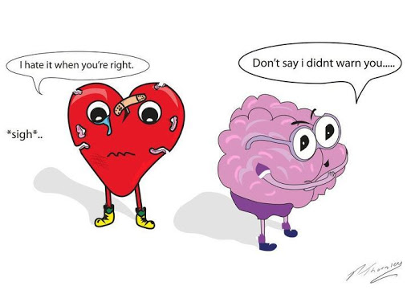

Slide 8
HOW CAN WE TELL IF
WHAT WE’RE FEELING IS DEFINITELY LOVE?

Slide 9
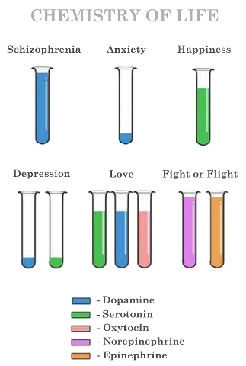

Slide 10
YOU WANT THEM TO CALL, TO WRITE, AND THERE’S AN INTENSE MOTIVATION TO WIN THE PERSON.

Slide 11
DOES LOVE LAST FOREVER?

Slide 12
SOMETIMES WE’RE NOT CAPABLE OF FEELING EMOTIONS SUCH AS LOVE, SOMETIMES WE GO THROUGH FLAT MOMENTS WHERE WE CAN’T FEEL ANYTHING.

Slide 13
ARE THERE DIFFERENT TYPES OF LOVE?

Slide 14
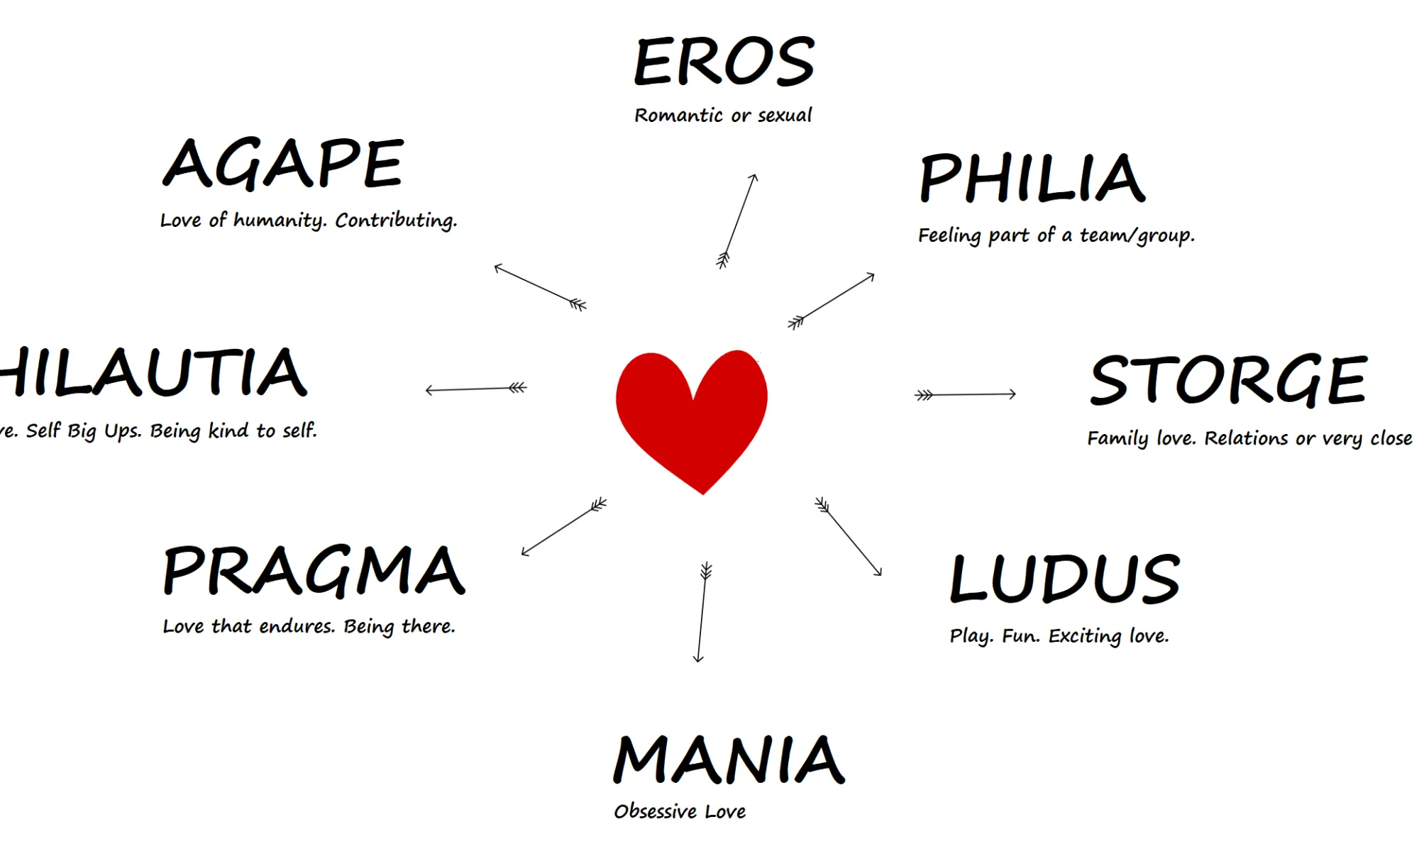

Slide 15
DOES LOVE AT FIRST SIGHT EXIST?

Slide 16
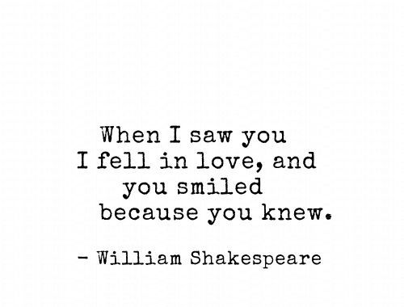

Slide 17
AND THAT ABOUT MARRIAGE?

Slide 18
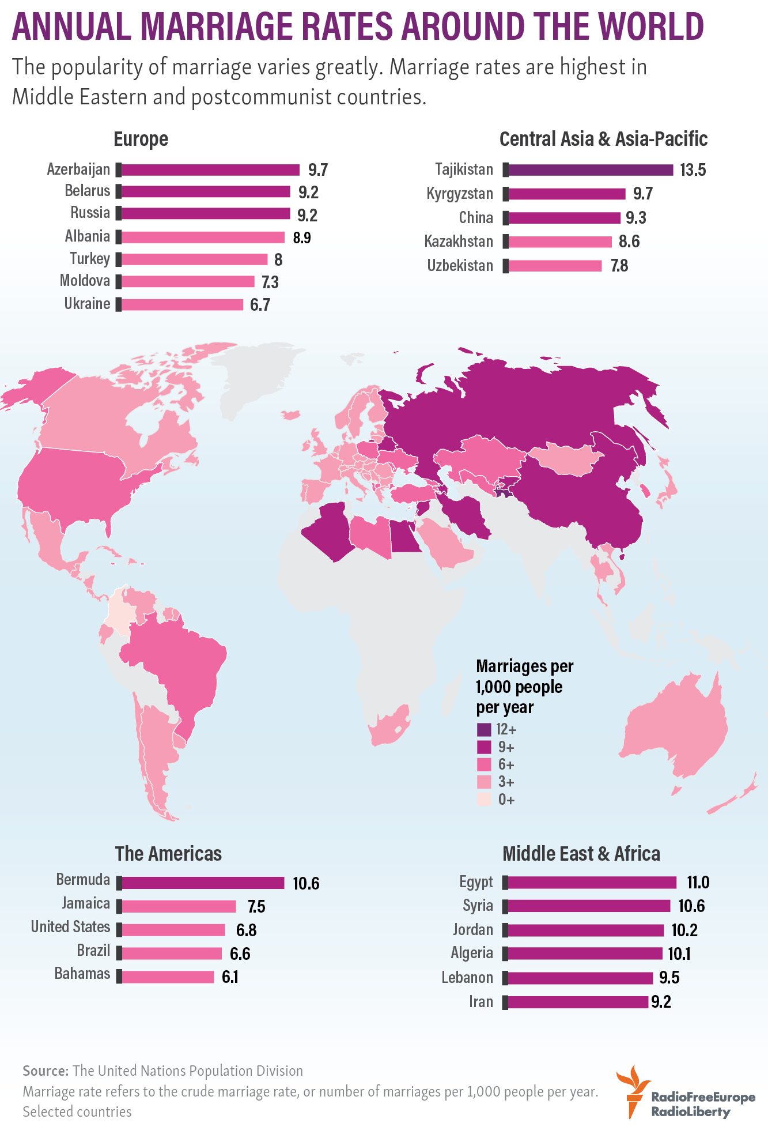

Slide 19
WHY PEOPLE GET MARRIED?

Slide 20
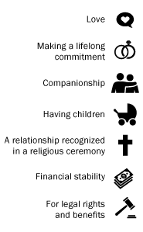
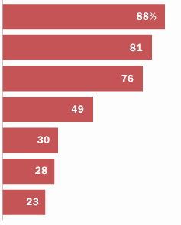

Slide 21
WHAT PURPOSE DOES LOVE SERVE?

Slide 22
LOVE HAS BEEN SERVING US TO BE GOOD TO EACH OTHER, TO BE SELFLESS SOMETIMES, AND TO REALLY TAKE INTO ACCOUNT OTHER PEOPLE’S NEEDS.

Slide 23
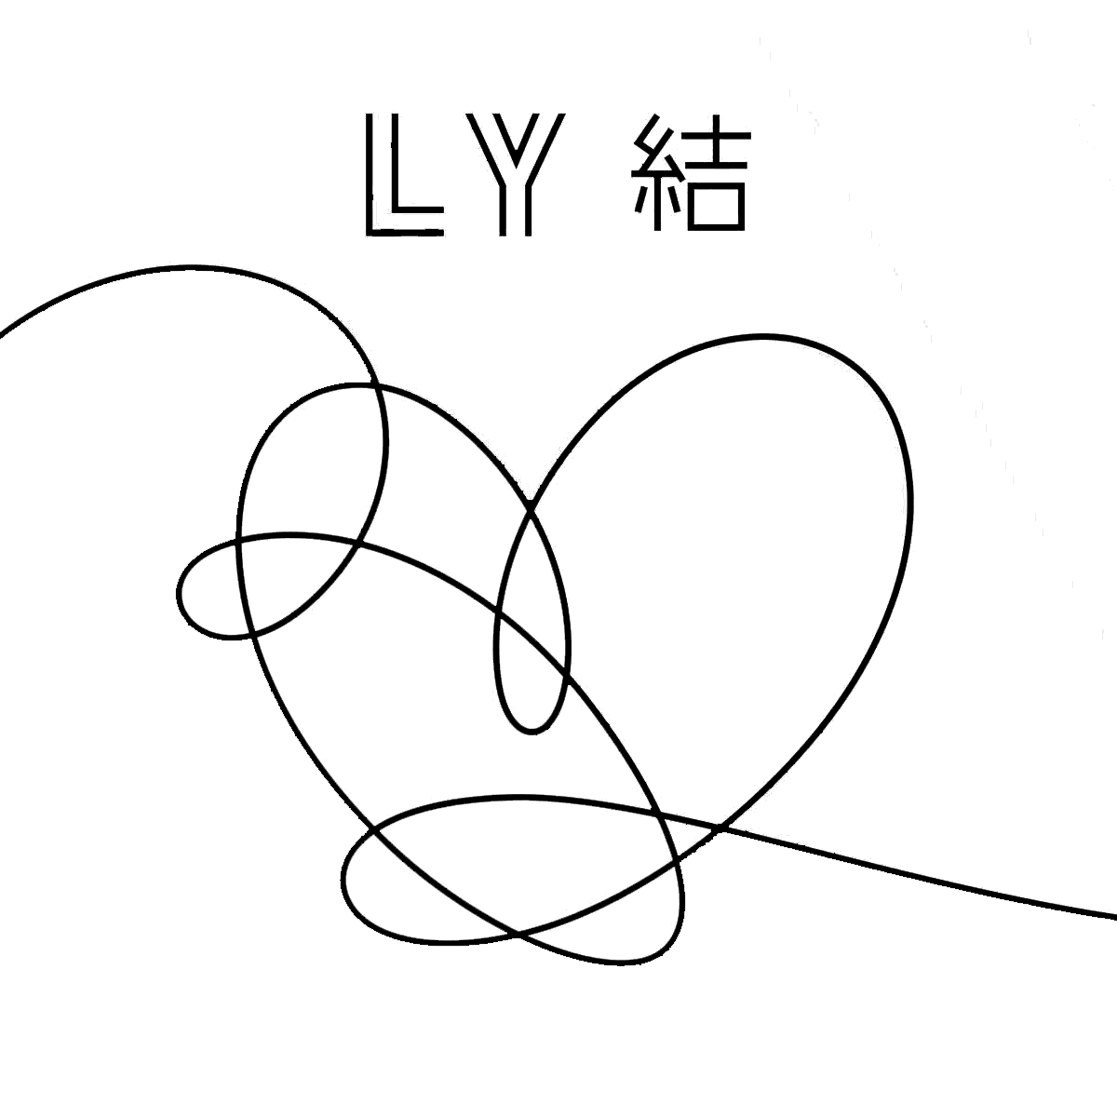
STAY TOGETHER AND BE IN LOVE

